Slide 1


http://pingo.edu.vn/khoa-hoc-php-can-ban/
PHP Basics – HTML - CSS
Web Applications in Hatch
Tuan Duong
http://pingo.edu.vn/tuan-duong/

Slide 2
Contents
Introduction
HTML
CSS

Slide 3
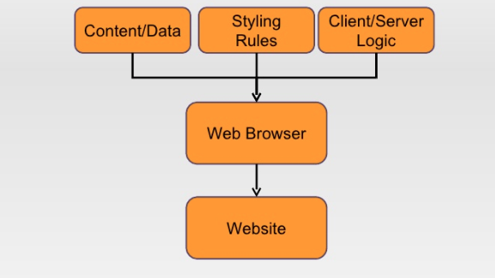
A webpage – broken down

Slide 4
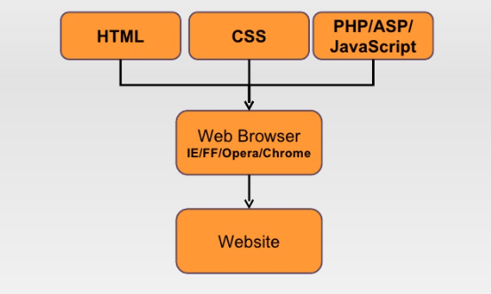
A webpage – broken down

Slide 5
What is HTML
HTML = Hyper Text Markup Language
A markup language designed for the creation of web pages and other information viewable in a browser.
File extension: .htm, .html

Slide 6
The basic tags
<html>
<head>
<title>My HTML webpage</title>
</head>
<body>
<h1>Hello everyone</h1>
</body>
</html>

Slide 7
The basic tags
<html>
<head>
<title>My HTML webpage</title>
</head>
<body>
<h1>Hello everyone</h1>
</body>
</html>

Slide 8
HTML Tags
A tag is: non-hierarchical keyword or term assigned to a piece of information.
Document Tags: The tags that are required for every HTML page we create
Tag usually goes with pair: an open tag (<form>) and an end tag (</form>)
< > : Opening tag
</ >: Closing tag

Slide 9
HTML Syntax
The element content is everything between the start and the end tag
<p>Hello World</p>
Some HTML elements have empty content
<br />
Most HTML elements can have attributes.
It’s not case sensitive - <p> means the same as <P>

Slide 10
HTML <body> tag
The body element defines the document’s body and contains all the contents of an HTML document, such as text, hyperlinks, images, tables, lists, etc,…
<html>
<head>
<title>My HTML page</title>
</head>
<body>
<h1>Hello everyone</h1>
<p>Webpage Contents</p>
<p>The content of the title element is displayed in the browser's title.</p>
</body>
</html>

Slide 11
HTML <body> tag
Attributes
bgcolor: Specifies a background-color for a HTML-page
<body bgcolor="000000">
<body bgcolor="rgb(0,0,0)">
<body bgcolor="black">
background: Specifies a background-image for a HTML-page
<body background="bg.gif">
<body bgcolor="rgb(0,0,0)" background="http://example.com/bg.gif">

Slide 12
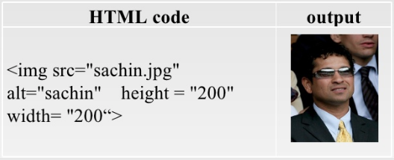
HTML <img> tag
The <img> tag embeds an image in a HTML-page
The <img> tag has attributes: src, alt, height, width

Slide 13
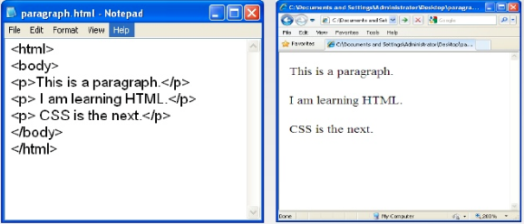
HTML <p> tag
The <p> tag defines a paragraph

Slide 14
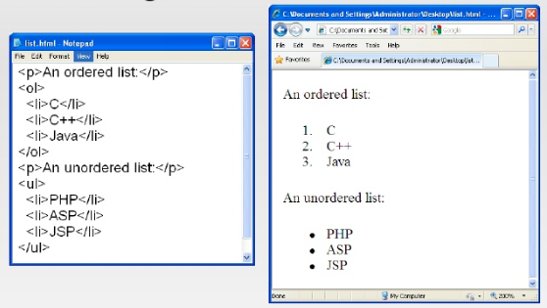
HTML <li> tag
The <li> tag defines a list item.

Slide 15
HTML <a> tag - Archor
The <a> tag defines an archor.
Attributes:
href=“URL”: HREF indicates the URL being linked to.
target: Specifies where to open the linked document ().
A Hypertext link
<a href="http://google.com">Google</a>
A Email link
<a href="mailto:bacduong@gmail.com">Email me now</a>

Slide 16
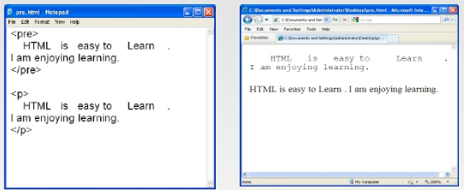
HTML <pre> tag
The <pre> tag defines preformatted text.
Text in a pre element is displayed in a fixed-width font (usually Courier), and it preserves both spaces and line breaks.

Slide 17
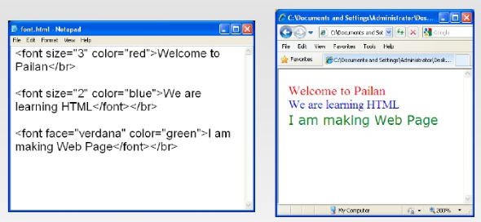
HTML <font> tag
The <font> tag specifies the font face, font size, and font color of text.

Slide 18
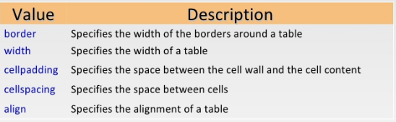
HTML <table> tag
The <table> tag defines and HTML table.
A simple HTML table consists of the table element and one or more tr, th, and td elements.
Attributes

Slide 19
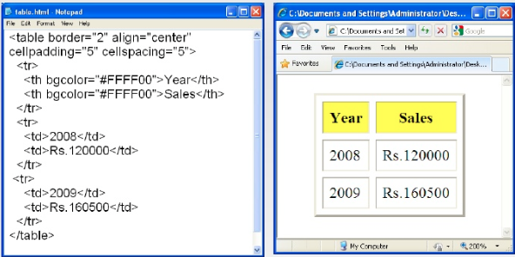
HTML <table> tag – example

Slide 20
HTML <form> tag
A form is an area that can contain form elements
Commonly used form elements includes:
Text fields
Radio buttons
Checkboxes
List boxes
Submit buttons

Slide 21
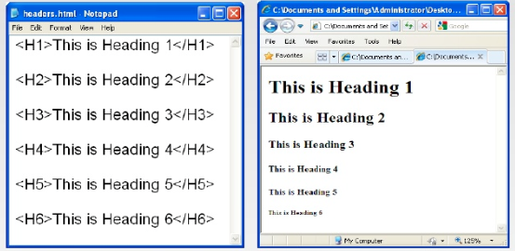
HTML Header tags
h1 defines the largest heading and <h6> defines the smallest heading

Slide 22
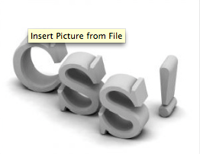
CSS

Slide 23
What is CSS
CSS = Cascading Style Sheet
CSS is a way to style HTML. Whereas the HTML is the content, the style sheet is the presentation of that document.

Slide 24

A Style
The property is followed by a colon (:) and the value is followed by a semicolon.

Slide 25
Applying CSS
There are three ways to apply CSS to HTML
Inline
Affects only the element applied to
Internal or Embedded
Affects only the elements in a single file
External
Linked to an unlimited number of files

Slide 26
Applying CSS
Inline
<p style="color: red;">Hello Kitty!</p>
Internal
<style type="text/css">
body {
font-family: Tahoma, Arial, sans-serif;
}
</style>
External
<link rel="stylesheet" type="text/css" href="web.css">

Slide 27
Inline Style Sheet
Inline styles are applied directly into the HTMLS tags using the style attribute.
<h3>Without CSS</h3>
<p>Hello Kitty!</p>
<h3 style="background: black;">With CSS</h3>
<p style="color: red;">Hello Kitty!</p>
<p style="color: green; font-style:italic;">Hello Kitty!</p>

Slide 28
Internal Style Sheet
Internal styles are used for the whole page. Inside the head tags, the style tags surround all of the styles for the page
<html>
<head>
<title>CSS Example for internal style sheet</title>
<style type="text/css">
p {
color: white;
background: blue;
}
</style>
</head>
<body>
<h3>Without css</h3>
<p>Hello Kitty!</p>
</body>
</html>

Slide 29
External Style Sheets
External style sheet are used for all pages that included the style sheets file using <link> tag
<html>
<head>
<title>CSS Example for internal applying style</title>
<link rel="stylesheet" type="text/css" href="style.css" />
</head>
<body>
<h3>Without css</h3>
<p>Hello Kitty!</p>
</body>
</html>

Slide 30
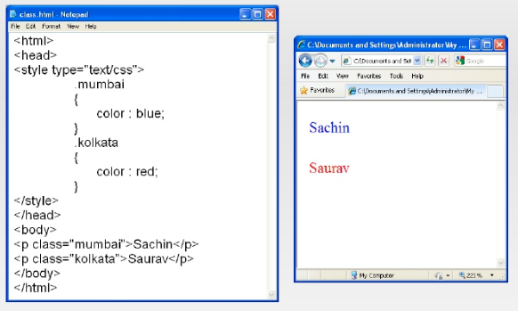
CSS class

Slide 31
PHP Basics - Strings

